Slide 1
Operating Systems

Slide 2
Overview
Operating System Evolution
Serial Processing
Batch processing
Multiprogrammed Batch Systems
Time Sharing Systems
Major Achievements in OS
Processes
Memory Management
Information protection and Security
Scheduling and Resource Management
Recent Developments
Microkernel architecture
Multithreading
Symmetric multiprocessing
Distributed OS and Object Oriented Design

Slide 3
Serial Processing
1940 to 1950
Programs in machine code were loaded via input device (Card Reader)
Errors are indicated through lights
Scheduling
Time slots are given to users based on the hardcopy sign sheet
Setup Time
Mounting/dismounting of tapes or setting up card desks will take time to set the inputs like compiler codes, functions, etc.

Slide 4
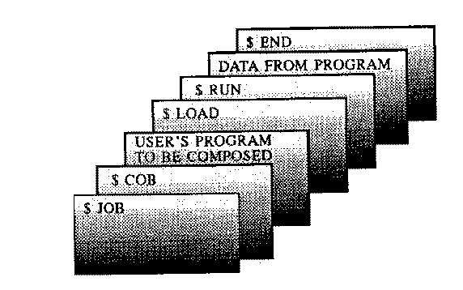
Batch Processing (cobol)

Slide 5
Batch Processing
Jobs with similar requirements were batched together
Tapes/cards were used
Example:
In one ForTran, one Cobol and another fortran programs are scheduled.
To reduce the operator time, two fortran compiler Tapes can be loaded and later the COBOL tapes can be loaded.

Slide 6
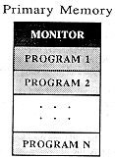
Multiprogramming
Used to increase the resource utilisation,
Allows more than one job (program) to utilize CPU time at any moment.
More number of programs competing for system resources, better will be resource utilisation

Slide 7
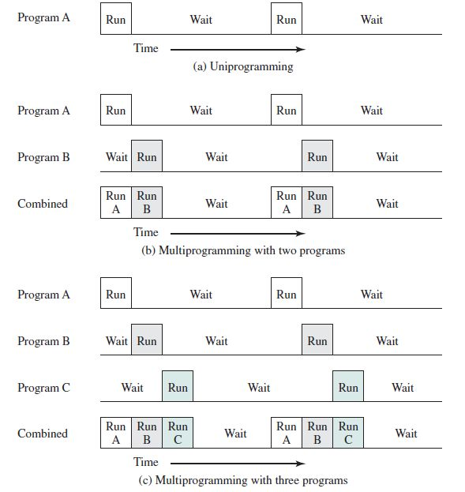
Multiprogramming

Slide 8
Multiprogramming

Slide 9
Multiprogramming

Slide 10
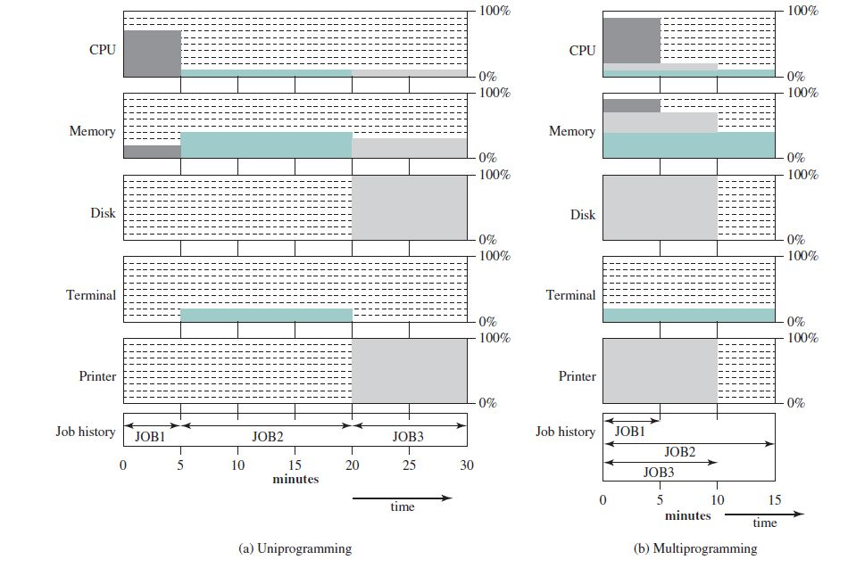
Multiprogramming

Slide 11
Major Achievements in OS

Slide 12
Overview
Operating System Evolution
Serial Processing
Batch processing
Multiprogrammed Batch Systems
Time Sharing Systems
Major Achievements in OS
Processes
Memory Management
Information protection and Security
Scheduling and Resource Management
Recent Developments
Microkernel architecture
Multithreading
Symmetric multiprocessing
Distributed OS and Object Oriented Design

Slide 13
Processes
A program in execution
An instance of a program running on a computer
The entity that can be assigned to and executed on a processor
A unit of activity characterized by a single sequential thread of execution, a current state, and an associated set of system resources

Slide 14
Processes
Challenges for processes
Multiprogramming batch operation
Time Sharing
Real Time Transaction Systems
Errors Encountered if the above challenges are not met
Improper synchornisation
Failed mutual exclusion
Non determinate program operation
Deadlocks

Slide 15
Memory Management
Responsibilities
Process isolation
Automatic allocation and Management
Support for Modular Programming
Protection and Access Control
Long Term Storage

Slide 16
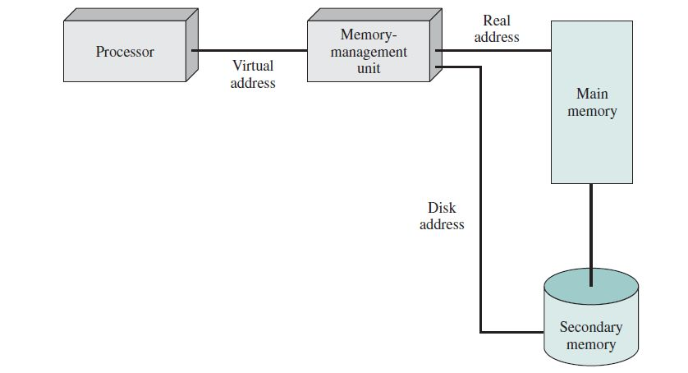
Virtual Memory

Slide 17
Virtual Memory
Pages
Processes to be comprised of a number of fixed sized blocks called pages
Real Address or physical address
Address of the main memory
Virtual Address
A page number and an offset
Address to be located from the secondary memory

Slide 18
Information protection
Availability: Concerned with protecting the system against interruption.
Confidentiality: Assures that users cannot read data for which access is unauthorized.
Data integrity: Protection of data from unauthorized modification.
Authenticity: Concerned with the proper verification of the identity of users and the validity of messages or data.

Slide 19
Scheduling and Resource Management
Resources are processors, I/O Devices, Memory, etc
Resource allocation and scheduling policy must consider these
Fairness
Allocate resources to all process fairly
Differential responsiveness
Each process needs different services, which has to be provided by the OS
Efficiency
Maximize throughput, minimize response time

Slide 20
OS Structure
Level | Name | Objects
13 | Shell | User programming Environment | OS Level components
12 | User Processes | User processes
11 | Directories | Directories
10 | Devices | External devices like printers, etc
9 | File System | Files
8 | Communications | Pipes
7 | Virtual Memory | Segments, pages
6 | Local Sec. Memory | Blocks of data, device channels
5 | Primitive processes | Semaphores. Ready list
4 | Interrupts | ISRs | Hardware Level
3 | Procedures | Call stack, procedures
2 | Instruction Set | Evaluation stack, scalar data
1 | Electronic Circuits | Registers, gates, buses

Slide 21
Recent Developments

Slide 22
Microkernel Architecture
Monolithic kernels are in demand today
Large kernels includes scheduling, file system, networking, device drivers, memory mgmt. and more.
Implemented as a single process with all elements sharing the same address space
Microkernel
Assigns only few essential functions in the kernel
Other OS services are provided by Servers or processes treated like any other application running under user mode.
This decouples kernel and server development.

Slide 23
Multithreading
Threads can run concurrently
Threads are also called as sub tasks or sub processes
Threads are process controlled entity wheresas the processes are kernel controlled entity
Threads of the same process share the common memory space available to that process

Slide 24
Symmetric multiprocessing (SMP)
The OS of an SMP schedules processes or threads across all of the processors.
SMP has the advantages
Performance
All the processes will work together for a given application
Availability
Even if one processor fails, the other will take care of the system with reduced performance
Incremental Growth
User can enhance by adding a new processor
Scaling
Vendors provides extra functionality based on the number of processors

